Slide 1
Arduino Electronic Load
Habid Rascon-Ramos

Slide 2
Arduino Electronic Load Review
Overview and Goals
Hardware Development Process
Final Product
Results

Slide 3
Overview
Electronic Load
Development tool
Power supply and battery testing
Current commercial options
Too expensive and overpowered

Slide 4
Goals
Open source
Cater to maker market
Make it programmable using Arduino
Deliverable: The load can maintain a 1A current draw for 1 hour at 5% accuracy

Slide 5
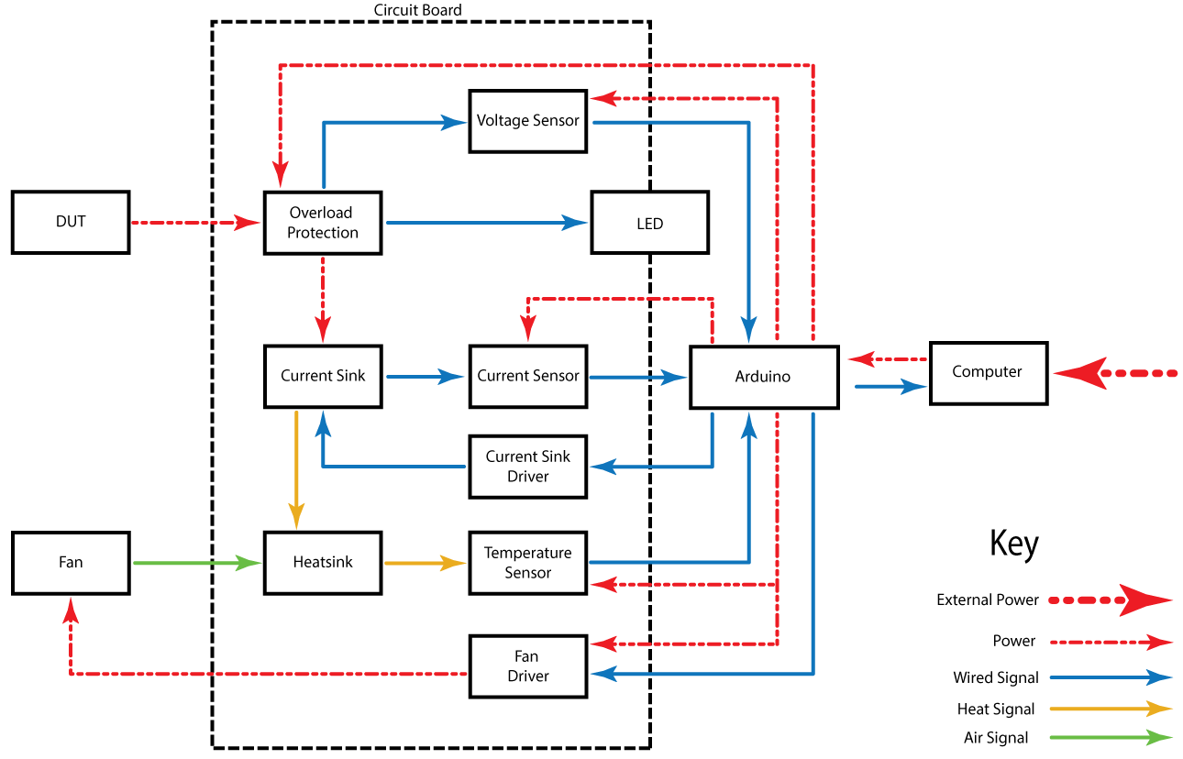
Product Definition: Feature Block Diagram

Slide 6
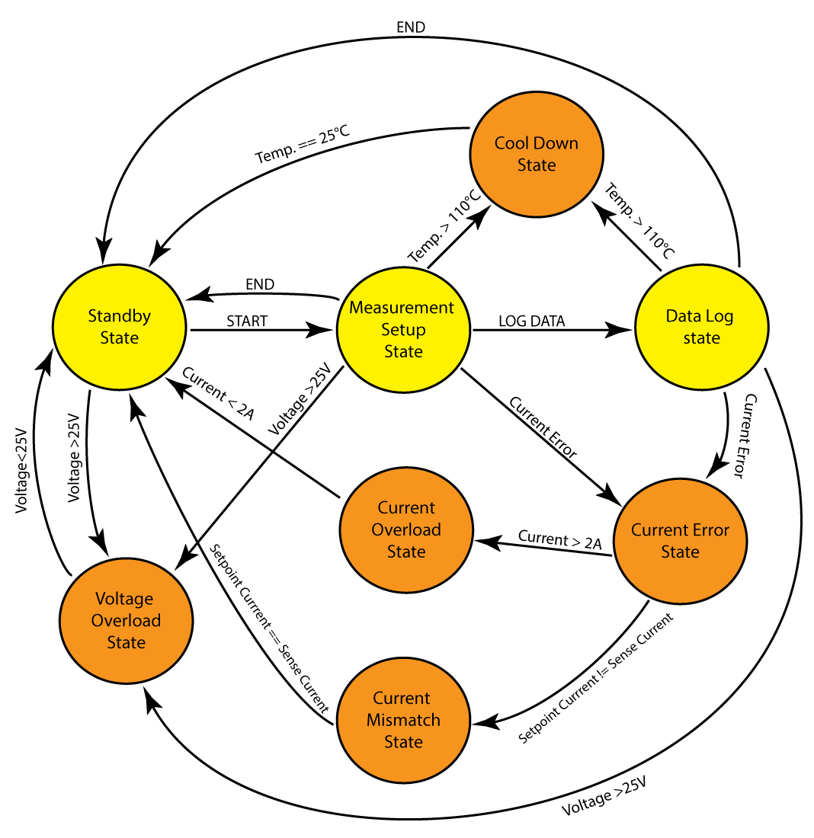
Product Definition: State Machine Flow Diagram

Slide 7
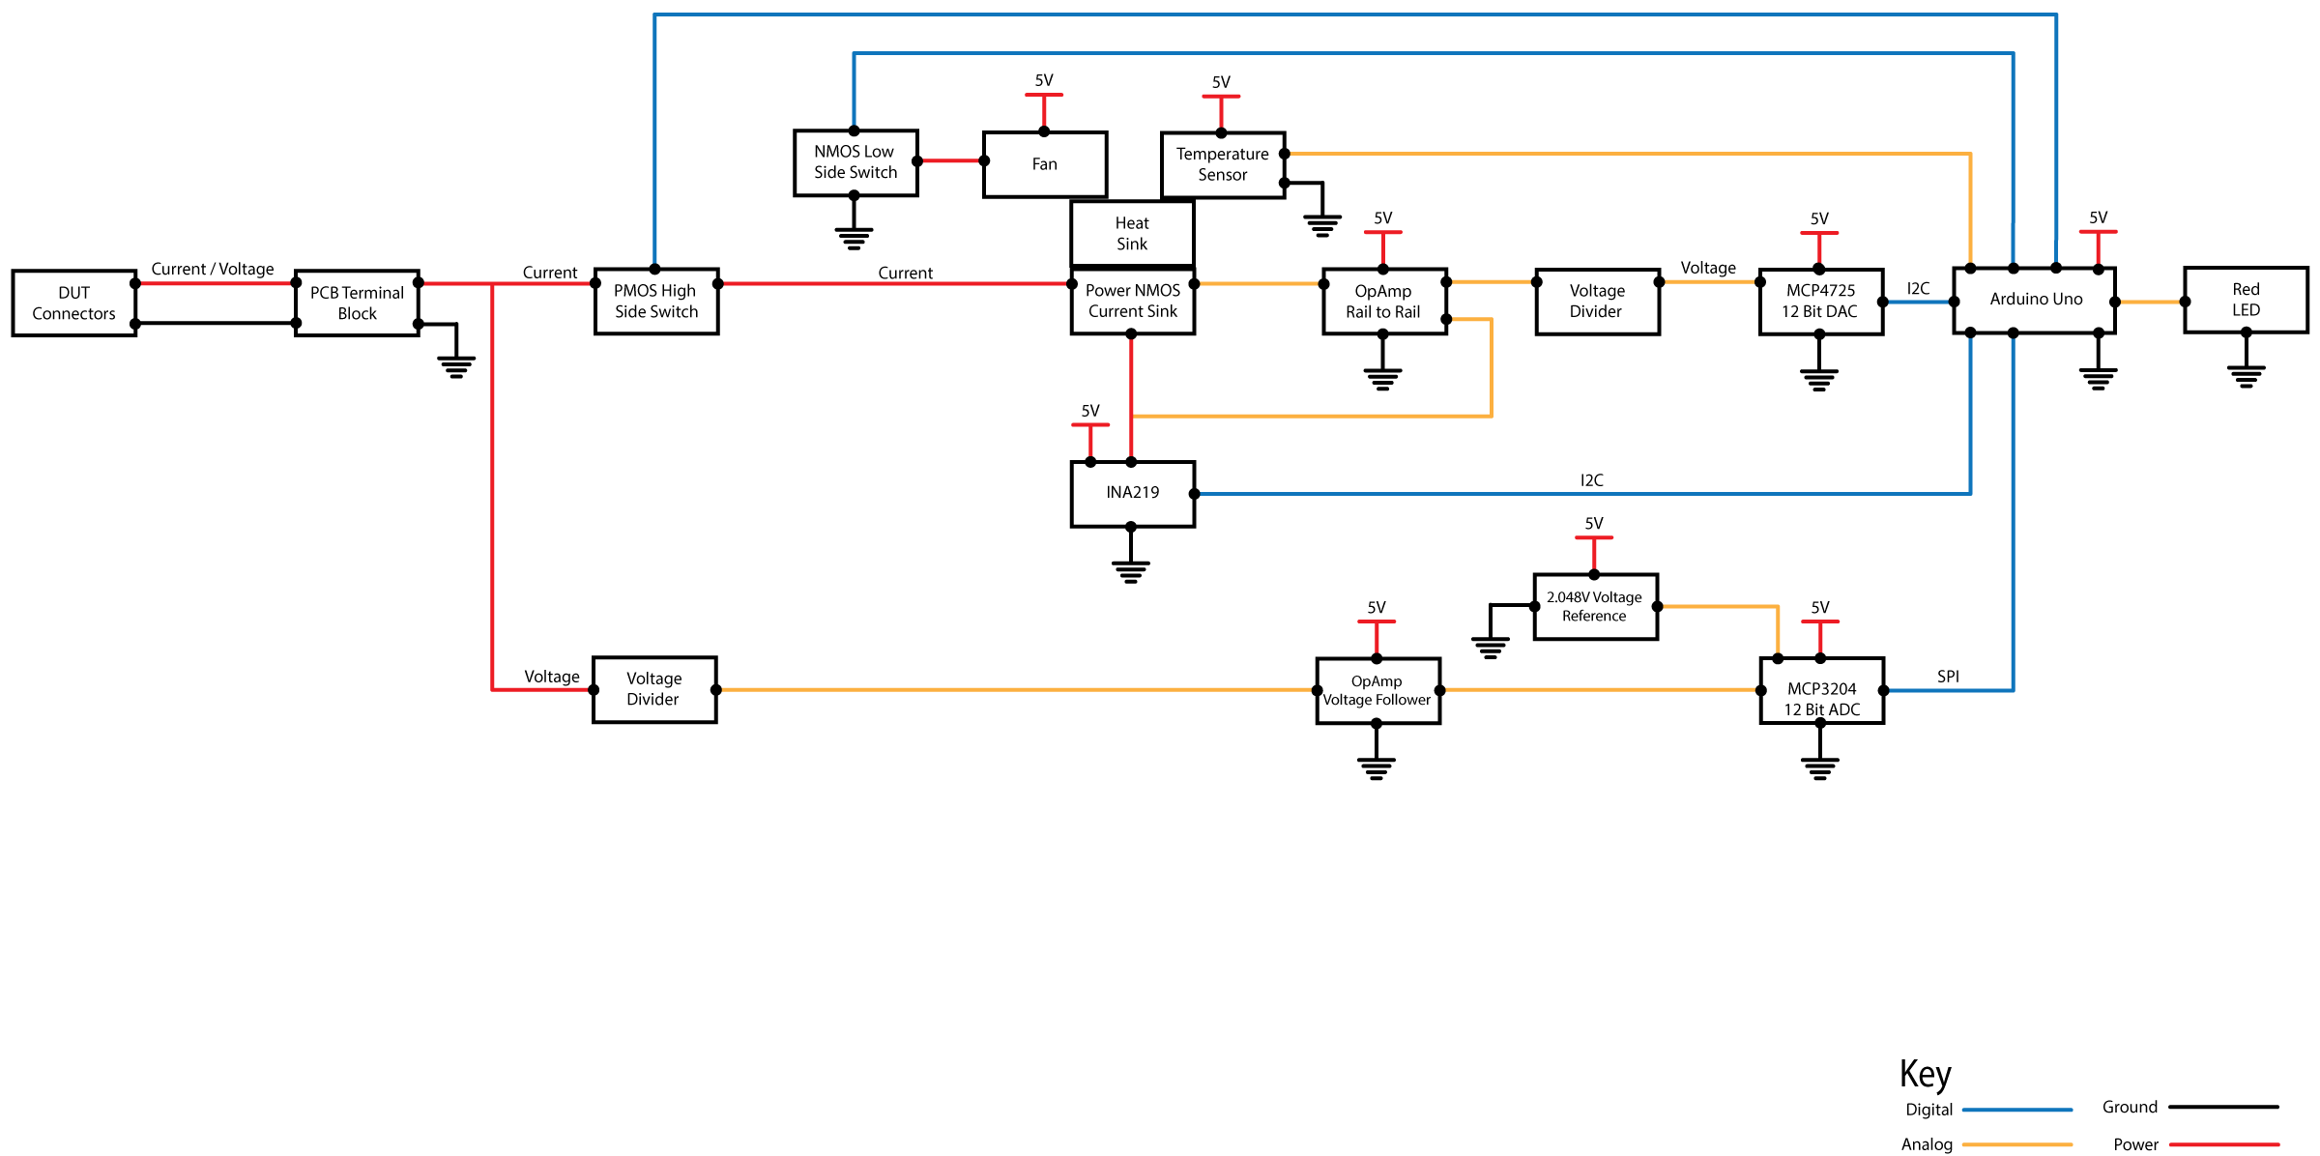
Architecture: Hardware Block Diagram

Slide 8
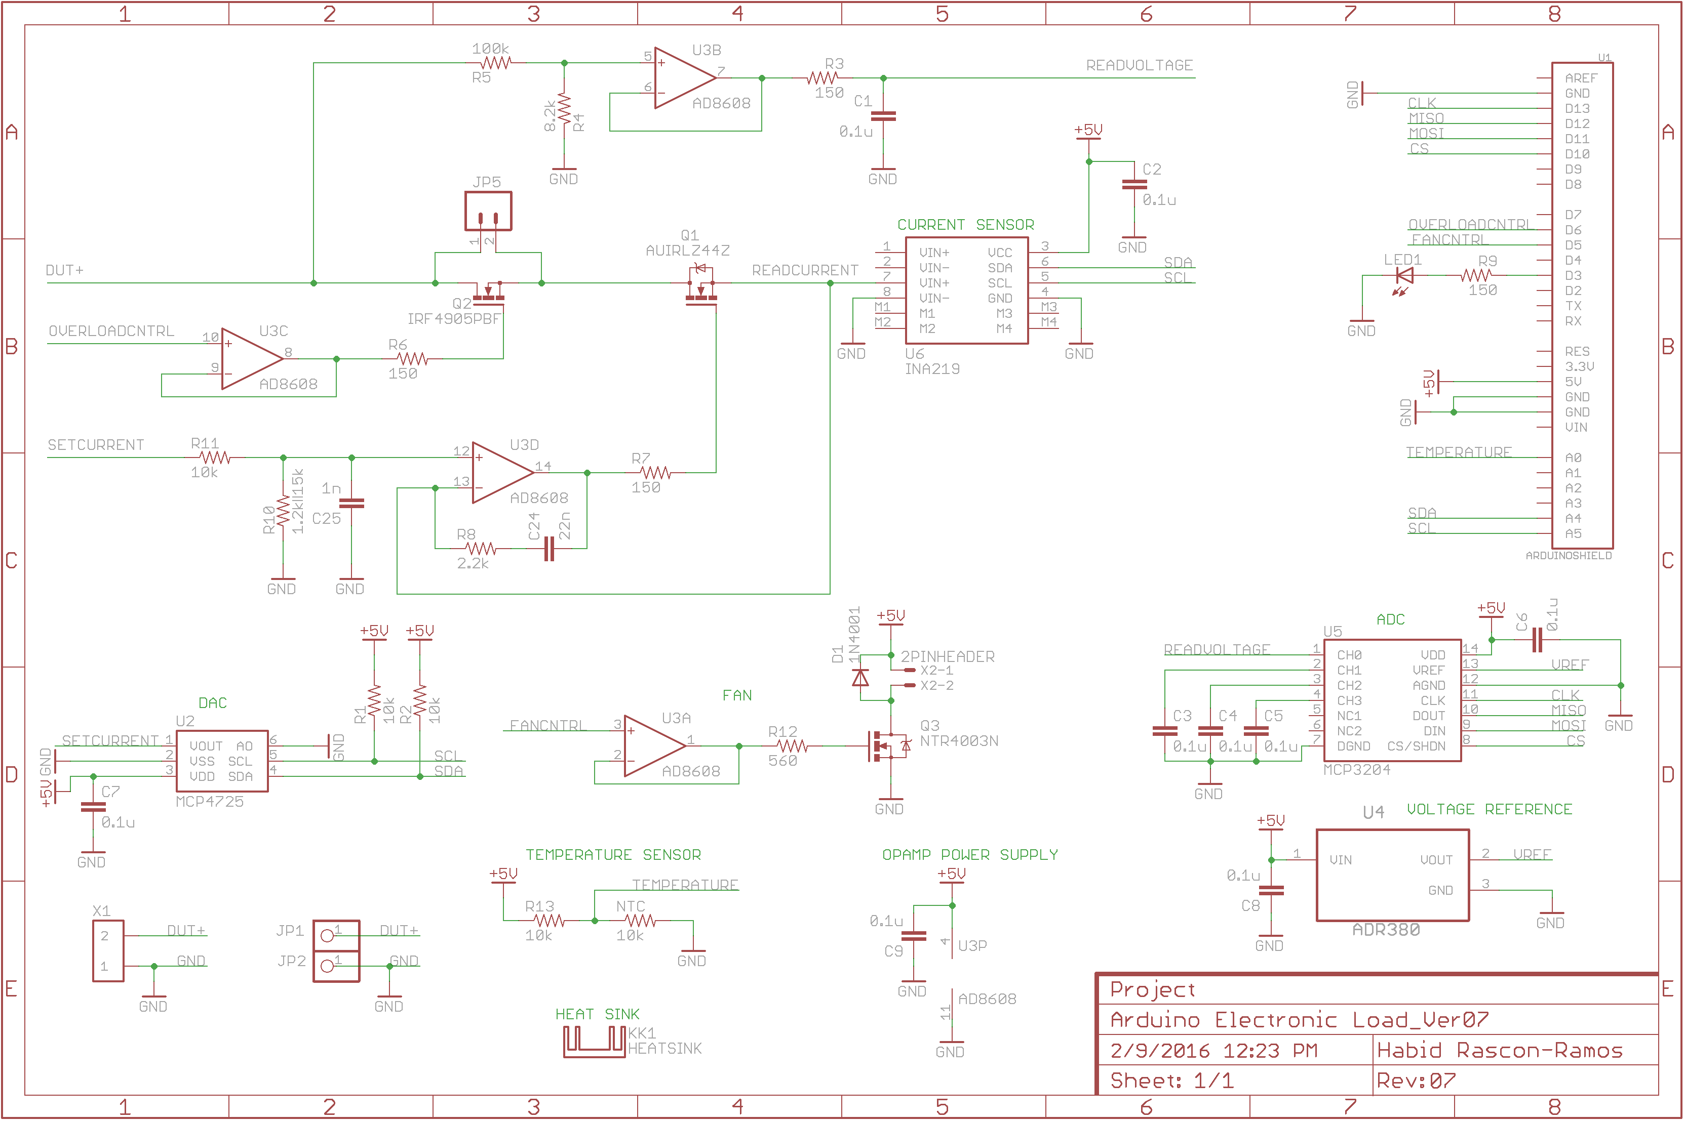
Realization: PCB Schematic

Slide 9
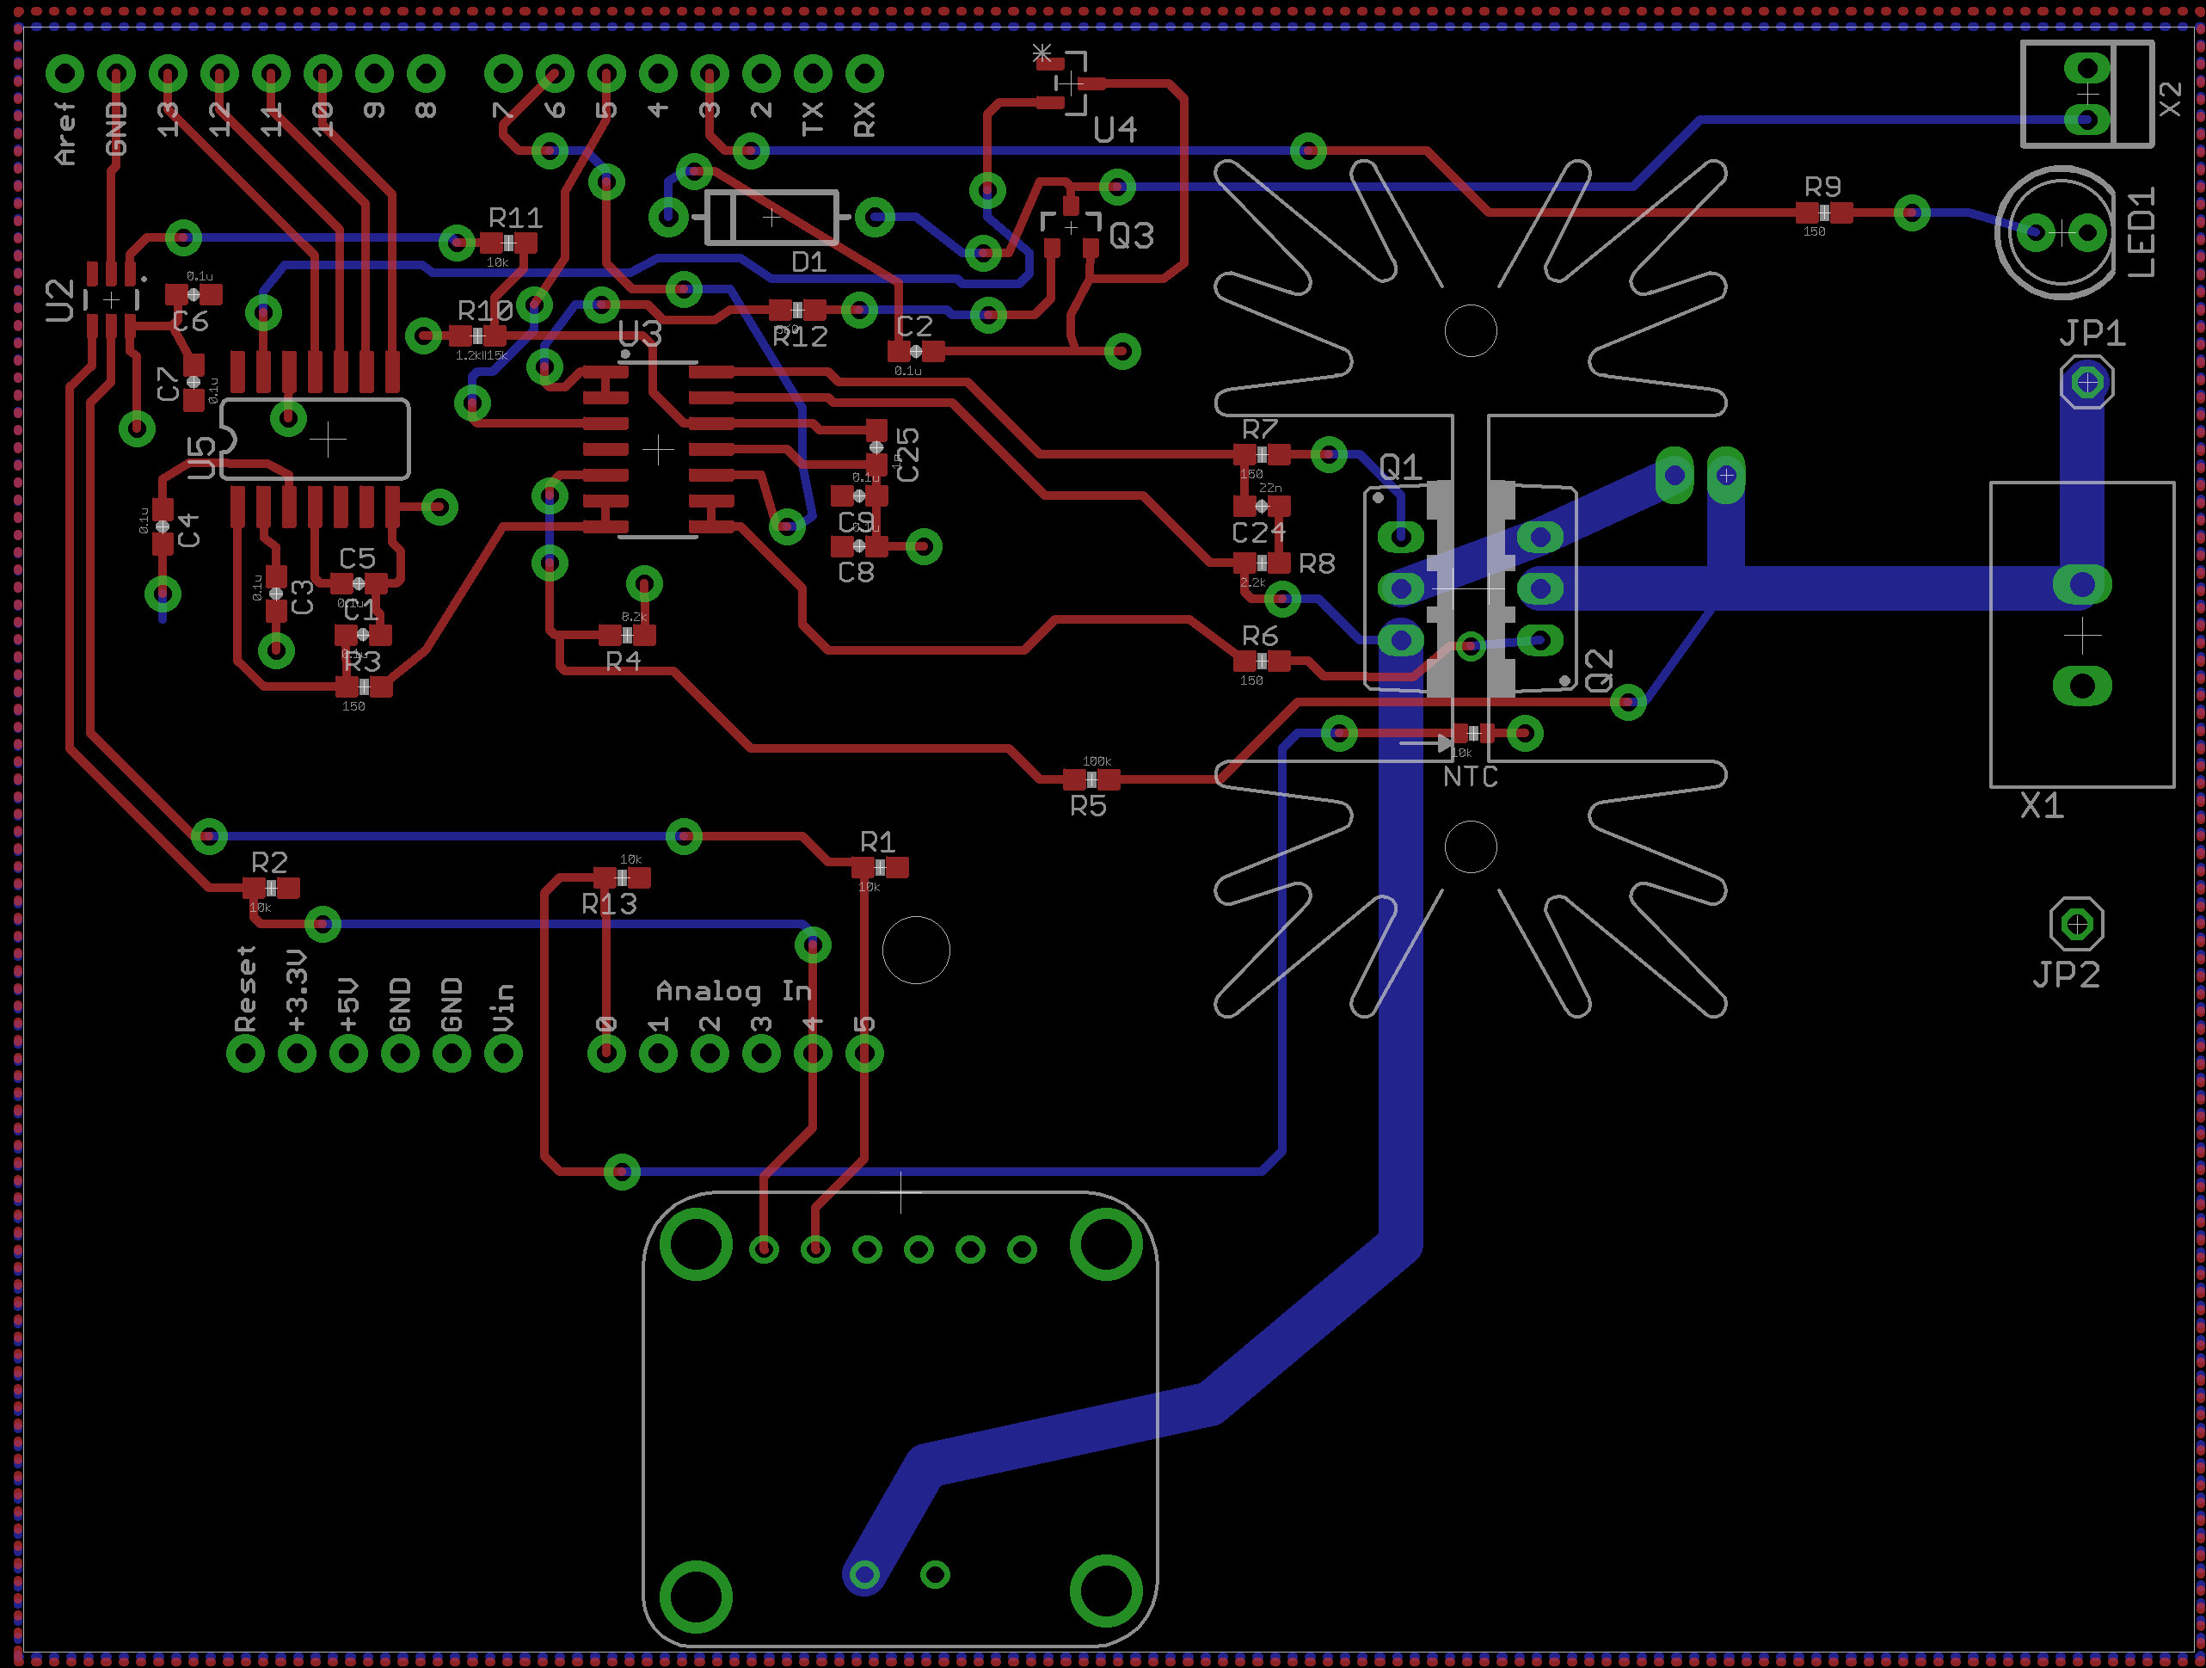
Realization: PCB Layout

Slide 10
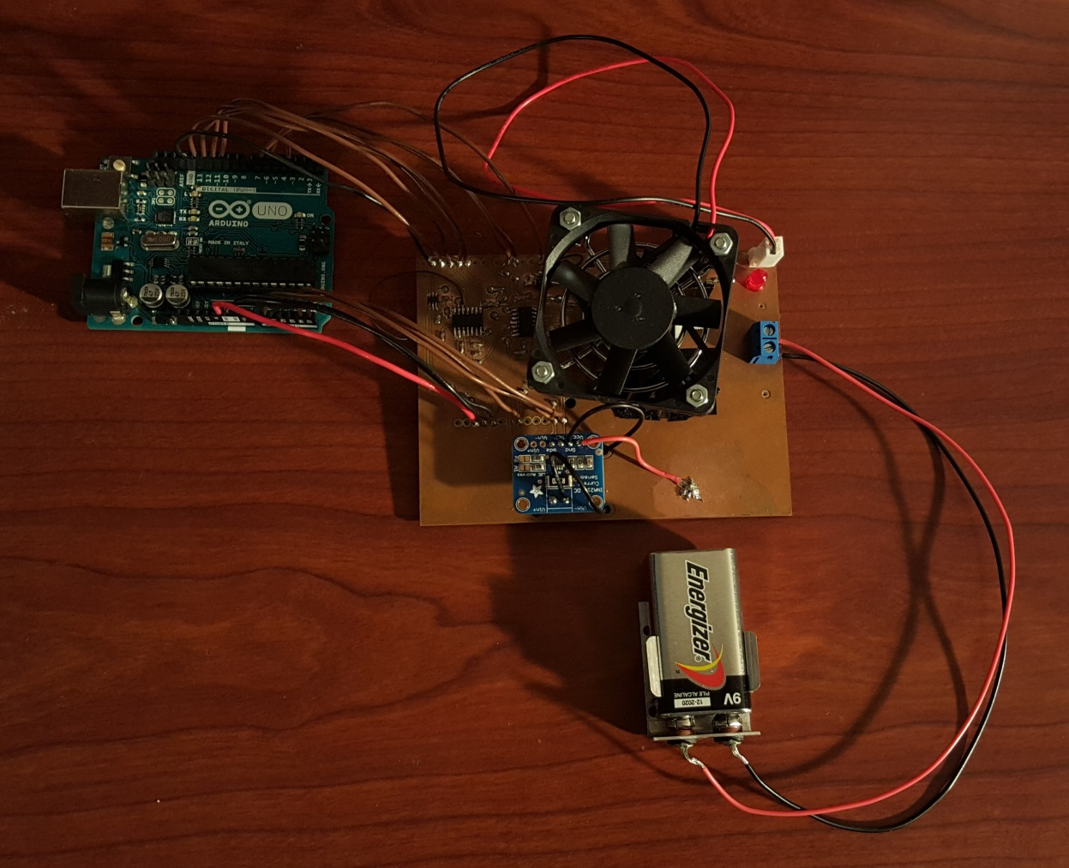
Final Product: Hardware

Slide 11
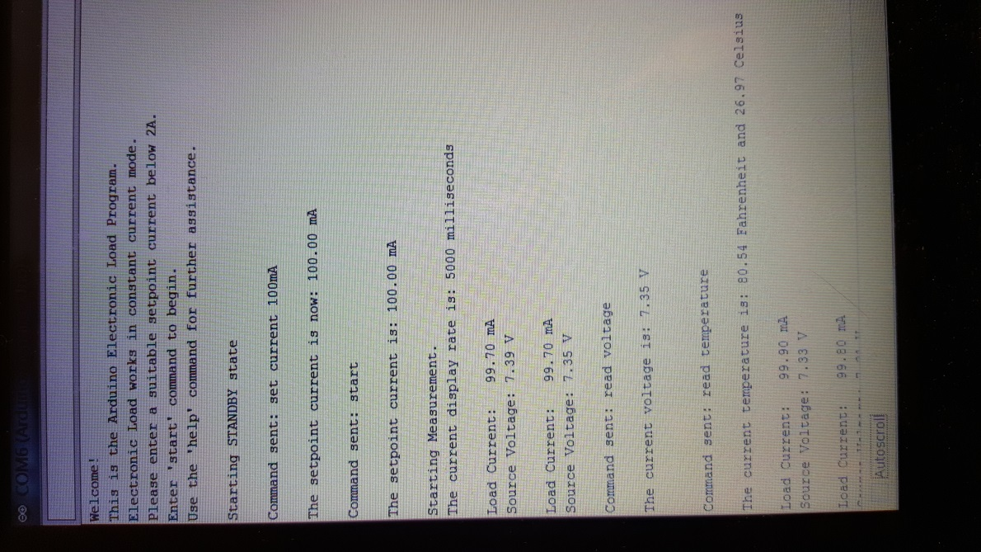
Final Product: Software

Slide 12
Results: Constant Current Test

Slide 13
Results: 9V Battery Test

